Slide 1
L02: Interactive Data Visualization with R-Shiny
EAS 509: Statistical Learning and Data Mining II
Video recording of this video is available at:
https://ub.hosted.panopto.com/Panopto/Pages/Viewer.aspx?id=524d7f93-c556-4011-af95-ae2f01345820

Slide 2
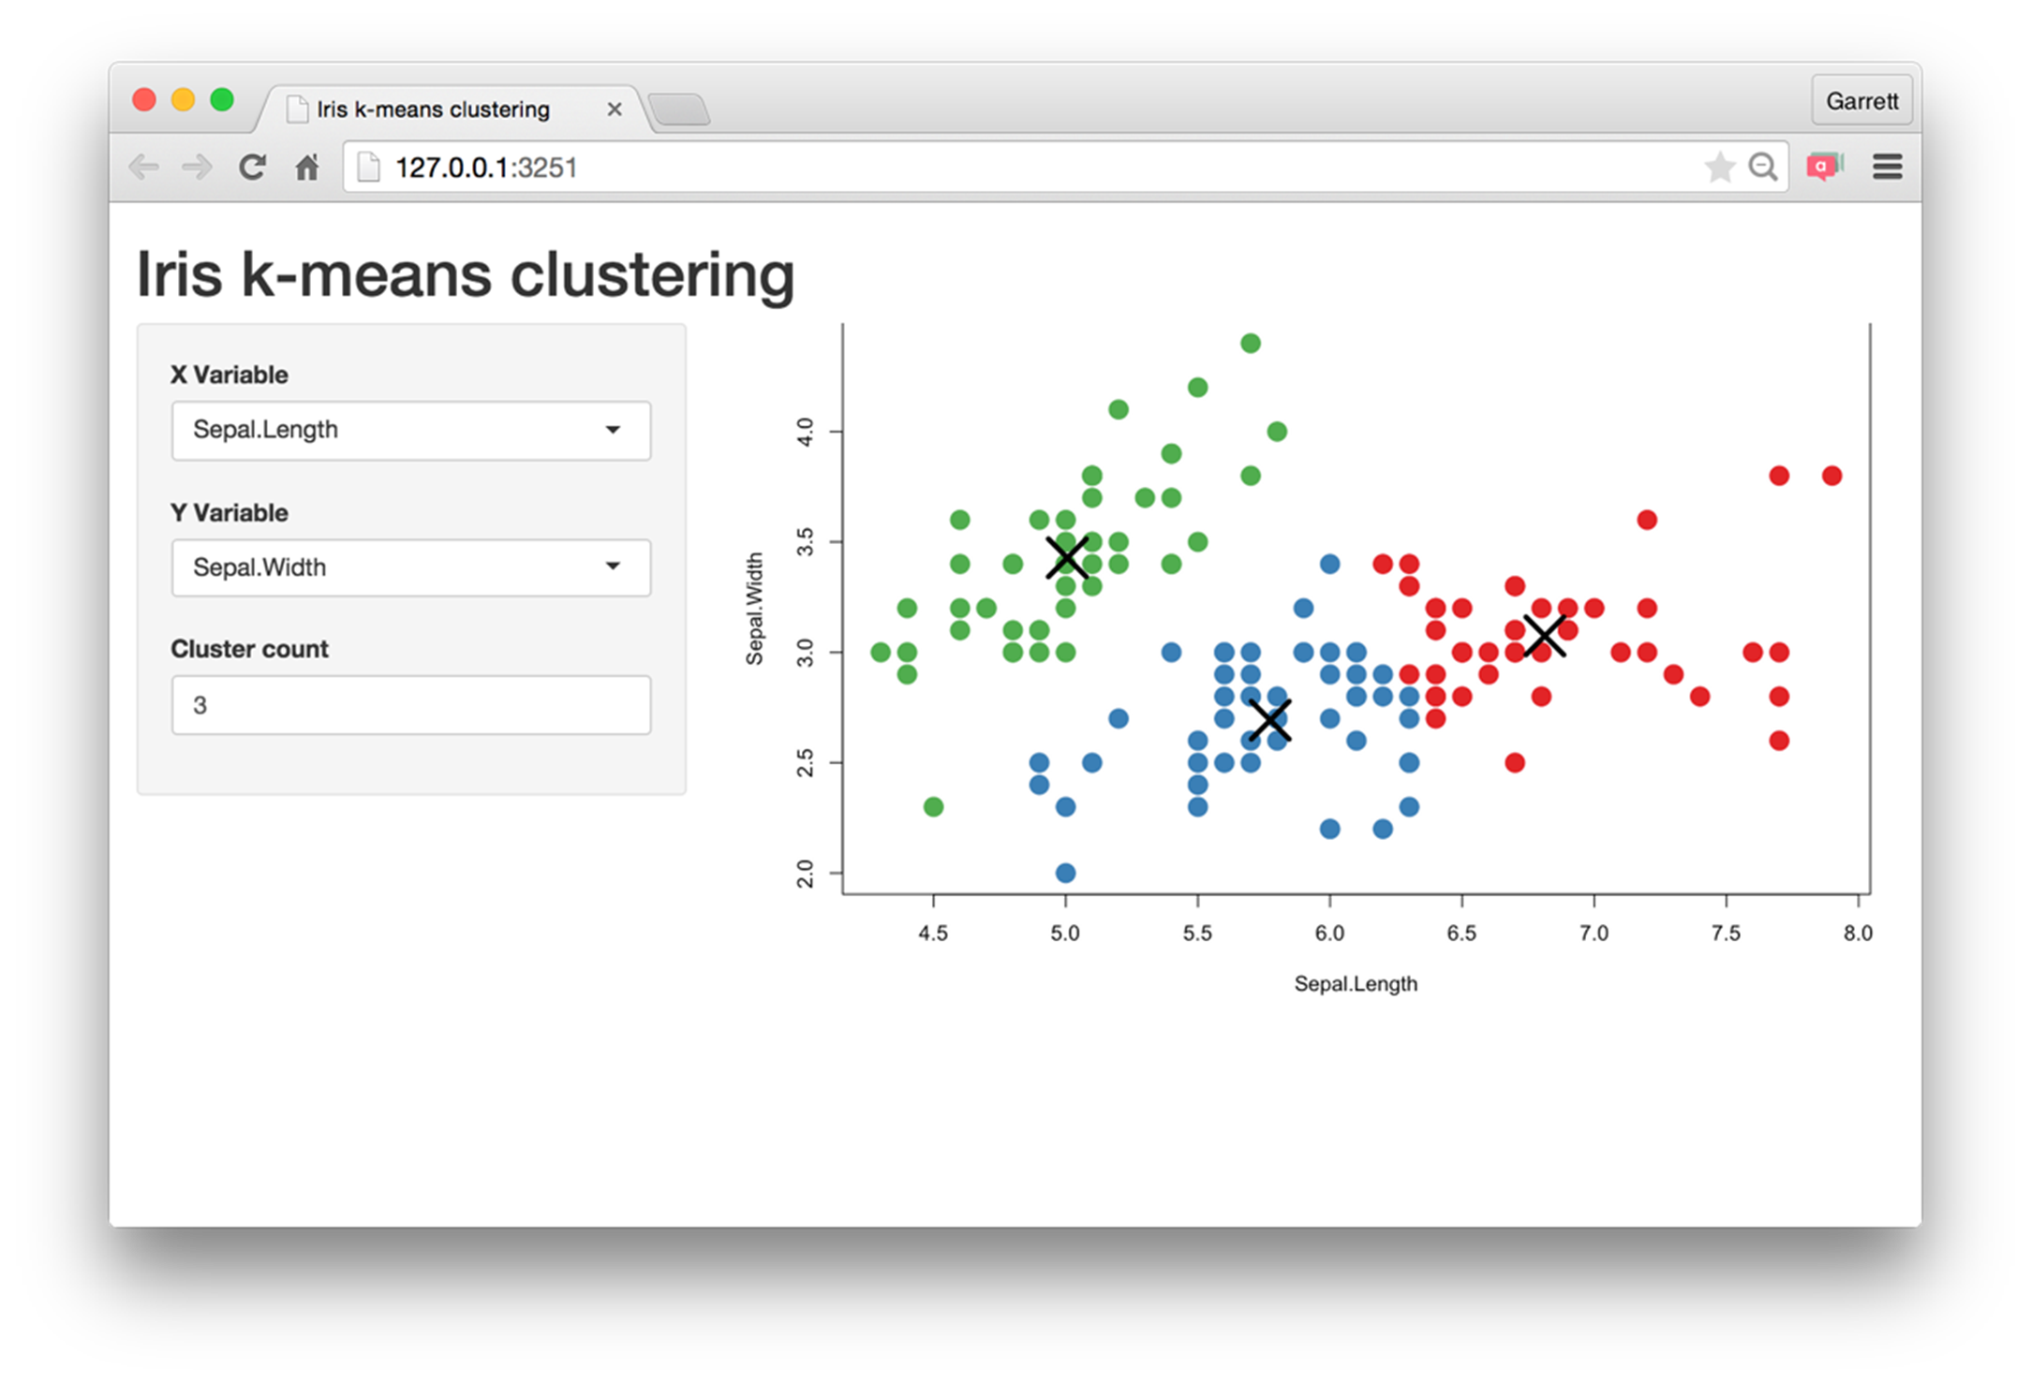
R-Shiny
Shiny – an R package for creating reactive web applications entirely in R.
Shiny’s reactive programming model allows R programmers to build upon their existing R knowledge and create data-driven web applications without any prior web programming experience.

Slide 3
Outline
Briefly go through official tutorial: https://shiny.rstudio.com/tutorial/
https://github.com/rstudio-education/shiny.rstudio.com-tutorial
Go through it slowly by your-self
Brief recap with R-shiny and Plotly

Slide 4
Rshiny - Documentation and Resources
Documentation: https://shiny.rstudio.com/articles/
Reference: https://shiny.rstudio.com/reference/shiny/
Official Tutorial: https://shiny.rstudio.com/tutorial/
https://github.com/rstudio-education/shiny.rstudio.com-tutorial
Examples: https://shiny.rstudio.com/gallery/
Book:
Mastering Shiny https://mastering-shiny.org/
Interactive web-based data visualization with R, plotly, and shiny by Carson Sievert https://plotly-r.com/

Slide 5

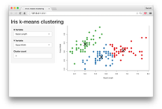



How to start with Shiny
Slides at: bit.ly/shiny-quickstart-1
official tutorial: https://shiny.rstudio.com/tutorial/
How to build a Shiny app
How to customize reactions
How to customize appearance

Slide 6
Understand the architecture

Slide 7




Understand the architecture
Every Shiny app is maintained by a computer running R
Server Instructions
User Interface (UI)

Slide 8
App template
The shortest viable shiny app
Slides at: bit.ly/shiny-quickstart-1
library(shiny) ui <- fluidPage()
server <- function(input, output) {} shinyApp(ui = ui, server = server)

Slide 9
Build your app around
Inputs and Outputs

Slide 10
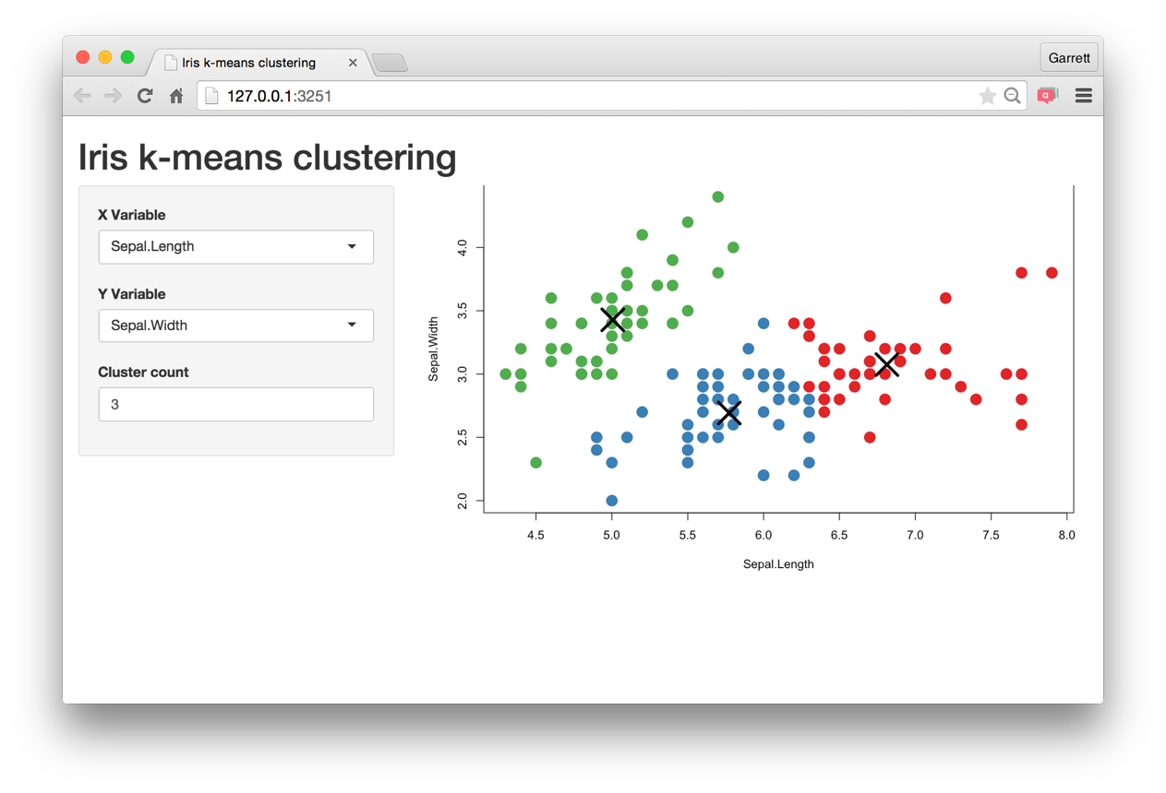
Slides at: bit.ly/shiny-quickstart-1
Build your app around inputs and outputs

Slide 11
Slides at: bit.ly/shiny-quickstart-1
Build your app around inputs and outputs

Slide 12
Add elements to your app as arguments to
fluidPage()
Slides at: bit.ly/shiny-quickstart-1
ui <- fluidPage(
# *Input() functions, # *Output() functions
)

Slide 13
Inputs

Slide 14
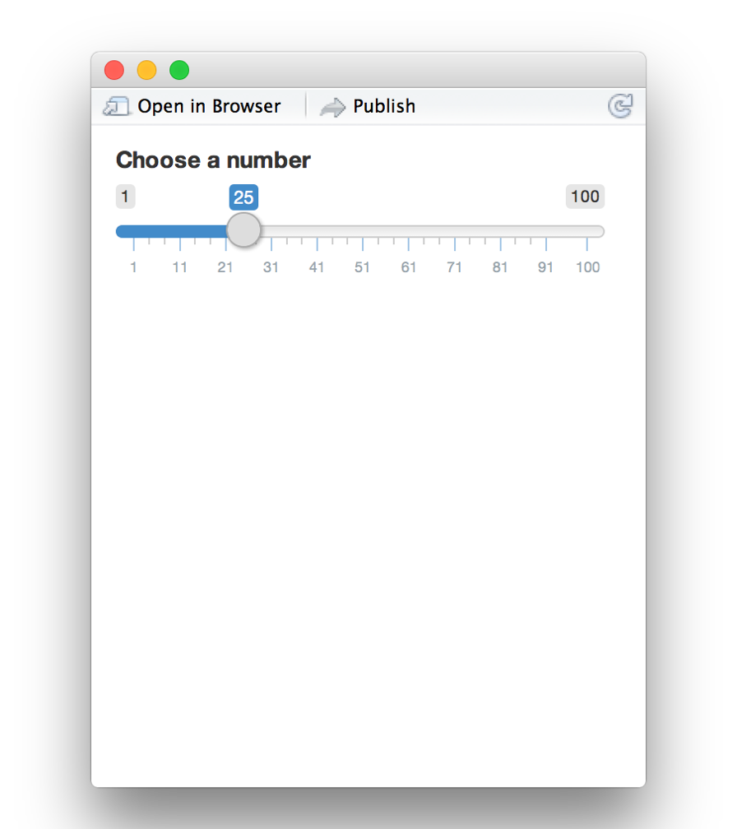
Create an input with an input function.
library(shiny) ui <- fluidPage(
sliderInput(inputId = "num", label = "Choose a number", value = 25, min = 1, max = 100)
)
server <- function(input, output) {} shinyApp(server = server, ui = ui)

Slide 15
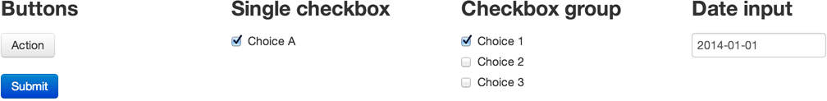
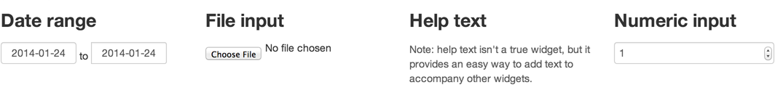
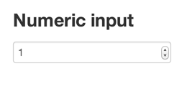
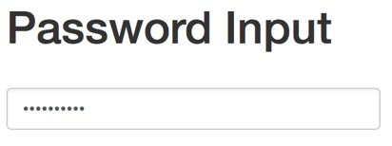
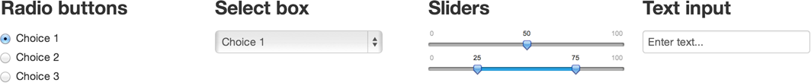
checkboxGroupInput() dateInput()
actionButton() submitButton()
checkboxInput()
dateRangeInput()
fileInput()
numericInput()
passwordInput()
radioButtons()
selectInput()
sliderInput()
textInput()

Slide 16
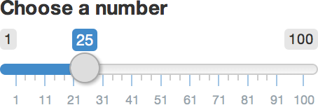
Syntax
Slides at: bit.ly/shiny-quickstart-1
sliderInput(inputId = "num", label = "Choose a number", …)
input name
(for internal use)
Notice: Id not ID
label to display
input specific arguments
?sliderInput

Slide 17
Outputs

Slide 18
Slides at: bit.ly/shiny-quickstart-1
Build your app around inputs and outputs

Slide 19


Slides at: bit.ly/shiny-quickstart-1
Function
Inserts
dataTableOutput() | an interactive table
htmlOutput() | raw HTML
imageOutput() | image
plotOutput() | plot
tableOutput() | table
textOutput() | text
uiOutput() | a Shiny UI element
verbatimTextOutput() | text

Slide 20
*Output()
Slides at: bit.ly/shiny-quickstart-1
To display output, add it to fluidPage() with an
*Output() function
plotOutput("hist")
the type of output to display
name to give to the output object

Slide 21
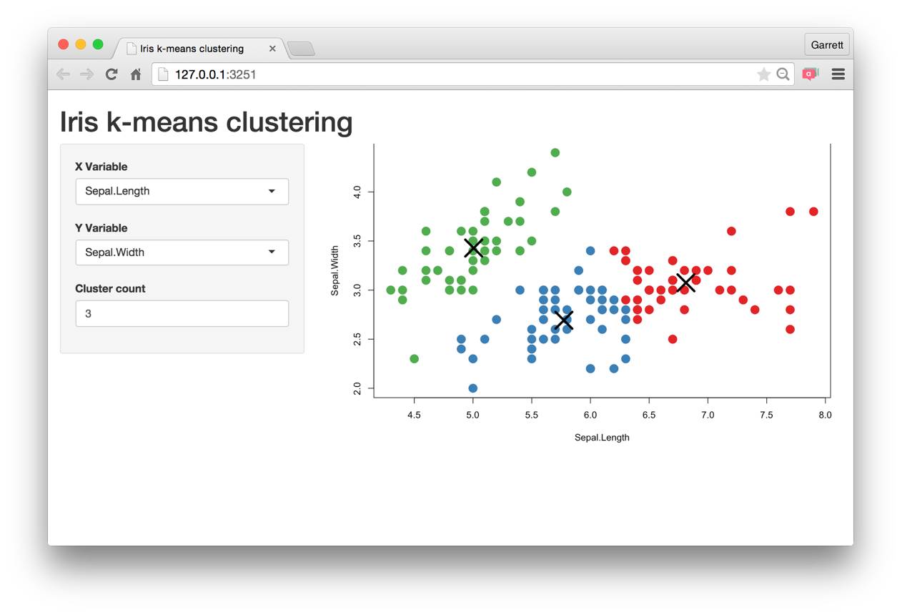
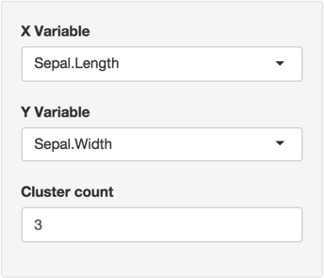
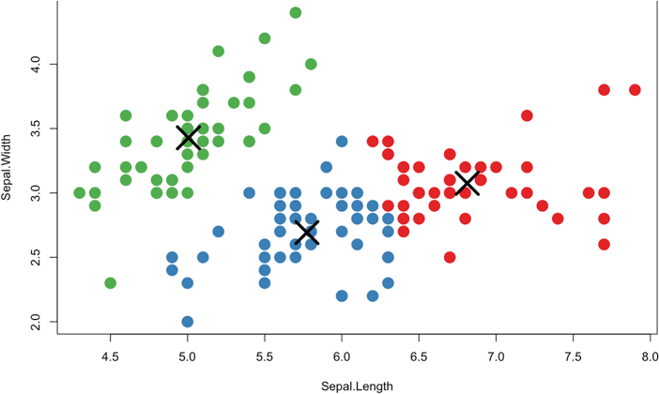

Recap
Slides at: bit.ly/shiny-quickstart-1
library(shiny) ui <- fluidPage()
server <- function(input, output) {} shinyApp(ui = ui, server = server)
Begin each app with the template
Hello World
Add elements as arguments to fluidPage()
Create reactive inputs with an *Input()
function
Display reactive results with an *Output()
function
Assemble outputs from inputs in the server function

Slide 22
Tell the
server
how to assemble
inputs into outputs

Slide 23
Use 3 rules to write the server function
Slides at: bit.ly/shiny-quickstart-1
server <- function(input, output) {
}

Slide 24
1
Slides at: bit.ly/shiny-quickstart-1
Save objects to display to output$
server <- function(input, output) { output$hist <- # code
}

Slide 25
1
Slides at: bit.ly/shiny-quickstart-1
Save objects to display to output$
output$hist
plotOutput("hist")

Slide 26
2
Slides at: bit.ly/shiny-quickstart-1
Build objects to display with render*()
server <- function(input, output) { output$hist <- renderPlot({
})
}

Slide 27


Use the render*() function that creates the type of output you wish to make.
Slides at: bit.ly/shiny-quickstart-1
function creates
renderDataTable() An interactive table
(from a data frame, matrix, or other table-like structure)
renderImage()
An image (saved as a link to a source file)
renderPlot()
A plot
renderPrint()
A code block of printed output
renderTable()
A table
(from a data frame, matrix, or other table-like structure)
renderText()
A character string
renderUI()
a Shiny UI element

Slide 28
render*()
Builds reactive output to display in UI
Slides at: bit.ly/shiny-quickstart-1
renderPlot({ hist(rnorm(100)) })
type of object to build
code block that builds the object

Slide 29
2
Slides at: bit.ly/shiny-quickstart-1
Build objects to display with render*()
server <- function(input, output) { output$hist <- renderPlot({
hist(rnorm(100))
})
}

Slide 30
2
Slides at: bit.ly/shiny-quickstart-1
Build objects to display with render*()
server <- function(input, output) { output$hist <- renderPlot({
title <- "100 random normal values" hist(rnorm(100), main = title)
})
}

Slide 31
3
Slides at: bit.ly/shiny-quickstart-1
Access input values with input$
server <- function(input, output) { output$hist <- renderPlot({
hist(rnorm(input$num))
})
}

Slide 32
3
Slides at: bit.ly/shiny-quickstart-1
Access input values with input$
sliderInput(inputId = "num",…)
input$num

Slide 33
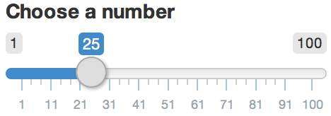
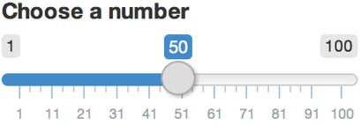
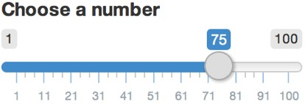
Input values
Slides at: bit.ly/shiny-quickstart-1
The input value changes whenever a user changes the input.
input$num = 25
input$num = 50
input$num = 75

Slide 34
Input values
Slides at: bit.ly/shiny-quickstart-1
The input value changes whenever a user changes the input.
input$num = 25
input$num = 50
Output will automatically update
if you follow the 3 rules
input$num = 75

Slide 35
Reactivity 101
Slides at: bit.ly/shinyLONDON
Reactivity automatically occurs whenever you use an input value to render an output object
function(input, output) { output$hist <- renderPlot({
hist(rnorm(input$num))
})
})

Slide 36
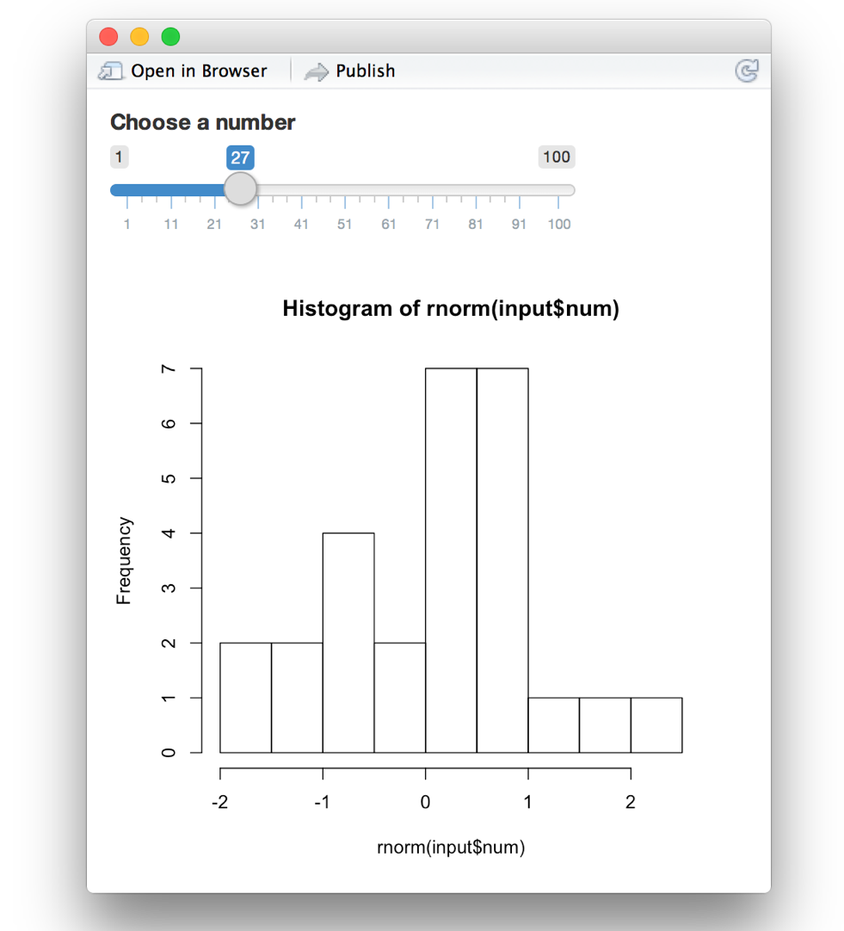
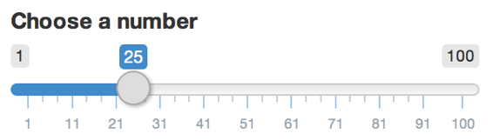
input$num
renderPlot({ hist(rnorm(input$num))
})

Slide 37
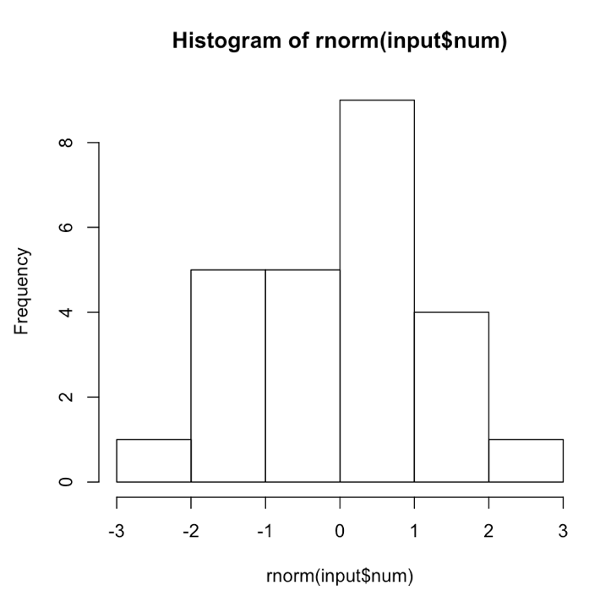
input$num
renderPlot({ hist(rnorm(input$num))
})

Slide 38


Recap: Server
Slides at: bit.ly/shiny-quickstart-1
Use the server function to assemble inputs into outputs. Follow 3 rules:
output$hist <-
1. Save the output that you build to output$
renderPlot({
hist(rnorm(input$num))
})
2. Build the output with a render*() function
input$num
3. Access input values with input$
Create reactivity by using Inputs to build
rendered Outputs

Slide 39
What is Reactivity?

Slide 40
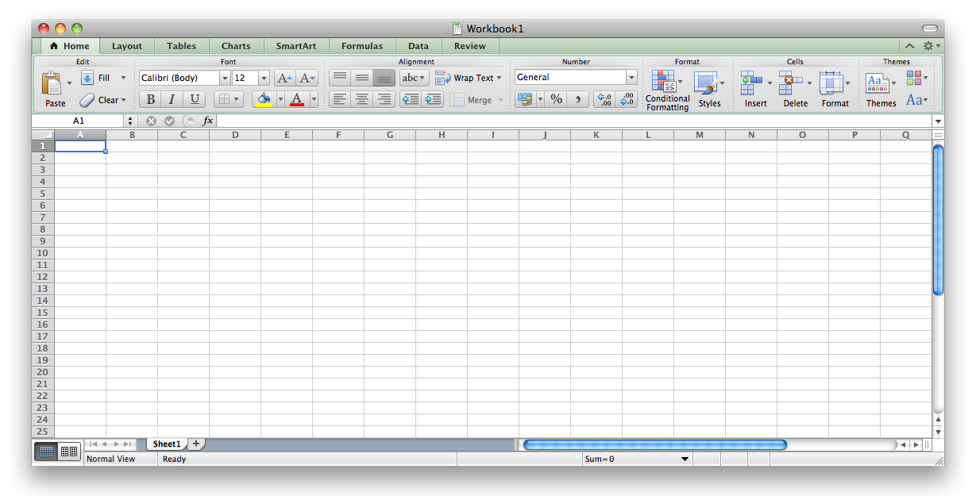
Slides at: bit.ly/shiny-quickstart-2
Think Excel.

Slide 41

Slides at: bit.ly/shiny-quickstart-2
run(this)
input$x
expression()
output$y
Update

Slide 42
Begin with
reactive values

Slide 43


Syntax
Slides at: bit.ly/shiny-quickstart-2
sliderInput(inputId = "num", label = "Choose a number", …)
this input will provide a value saved as input$num

Slide 44
Slides at: bit.ly/shiny-quickstart-2
Input values
The input value changes whenever a user changes the input.
input$num = 25
input$num = 50
input$num = 75

Slide 45
Reactive values work together with reactive functions. You cannot call a reactive value from outside of one.
Slides at: bit.ly/shiny-quickstart-2
$
renderPlot({ hist(rnorm(100, input$num)) })
#
hist(rnorm(100, input$num))

Slide 46
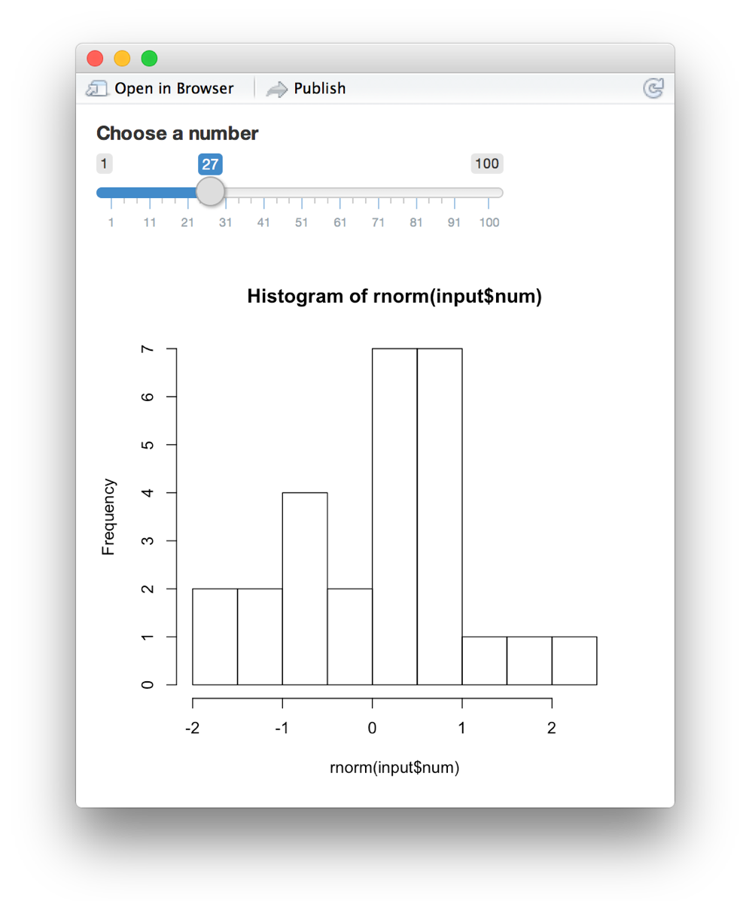

Think of reactivity in R as a two step process
1 Reactive values notify
the functions that use them when they become invalid
input$num
output$hist <- renderPlot({ hist(rnorm(input$num))
})

Slide 47
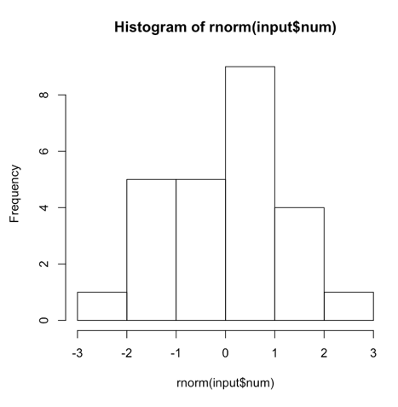
Think of reactivity in R as a two step process
1 Reactive values notify
the functions that use them when they become invalid
input$num
₂ The objects created by
reactive functions respond
(diﬀerent objects respond diﬀerently)
output$hist <- renderPlot({ hist(rnorm(input$num))
})

Slide 48


Slides at: bit.ly/shiny-quickstart-2
Recap: Reactive values
Reactive values act as the data
run(this)
input$x
expression()
output$y
streams that flow through your app.
Update
The input list is a list of reactive values. The values show the current state of the inputs.
input$num = 25
#
You can only call a reactive value from a function that is designed to work with one
input$num
Reactive values notify. The objects created by reactive functions respond.
output$hist

Slide 49
Reactive toolkit
(7 indispensible functions)

Slide 50
Reactive functions
Slides at: bit.ly/shiny-quickstart-2
1
Use a code chunk to build (and rebuild) an object
What code will the function use?
₂ The object will respond to changes in a set of
reactive values
Which reactive values will the object respond to?
© CC 2015 RStudio, Inc.

Slide 51
Display output with render*()

Slide 52
Render functions build output to display in the app
Slides at: bit.ly/shiny-quickstart-2
function creates
renderDataTable() An interactive table
(from a data frame, matrix, or other table-like structure)
renderImage()
An image (saved as a link to a source file)
renderPlot()
A plot
renderPrint()
A code block of printed output
renderTable()
A table
(from a data frame, matrix, or other table-like structure)
renderText()
A character string
renderUI()
a Shiny UI element

Slide 53
render*()
Builds reactive output to display in UI
Slides at: bit.ly/shiny-quickstart-2
renderPlot( { hist(rnorm(input$num)) })
object will respond to every reactive value in the code
code used to build (and rebuild) object

Slide 54
render*()
Builds reactive output to display in UI
Slides at: bit.ly/shiny-quickstart-2
renderPlot( { hist(rnorm(input$num)) })
When notified that it is invalid, the object created by a render*() function will rerun the entire block of code associated with it

Slide 55
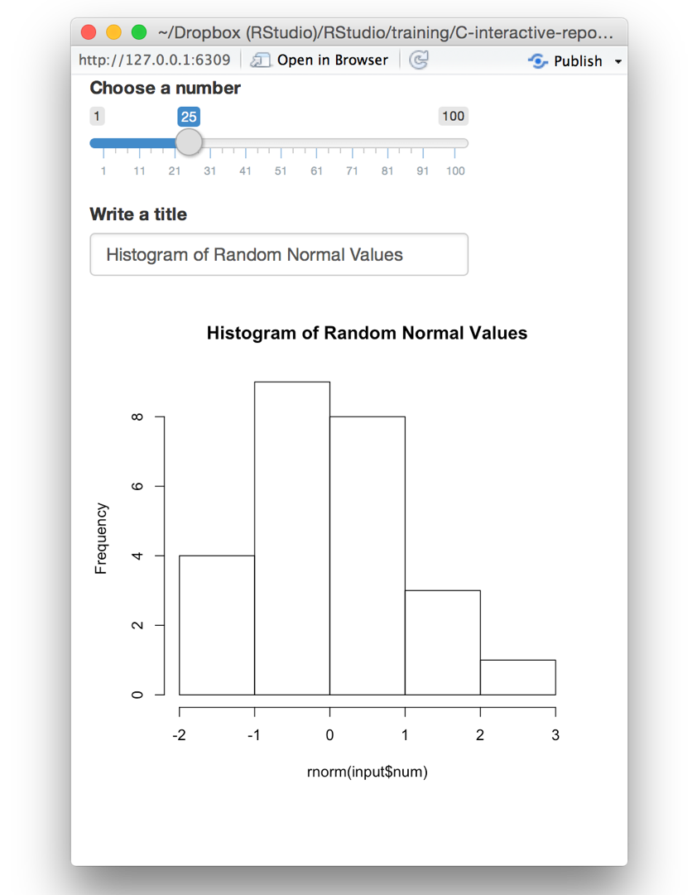
# 01-two-inputs
library(shiny) ui <- fluidPage(
sliderInput(inputId = "num", label = "Choose a number",
value = 25, min = 1, max = 100), textInput(inputId = "title",
label = "Write a title",
value = "Histogram of Random Normal Values"), plotOutput("hist")
)
server <- function(input, output) { output$hist <- renderPlot({
hist(rnorm(input$num), main = input$title)
})
}
shinyApp(ui = ui, server = server)

Slide 56

input$num
input$title
output$hist <- renderPlot({ hist(rnorm(input$num),
main = input$title)
})

Slide 57
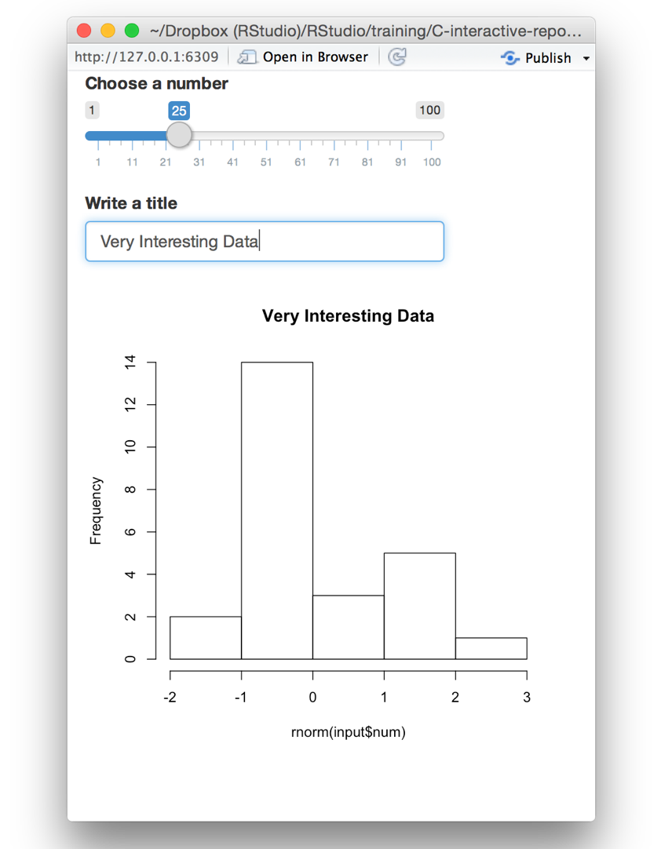
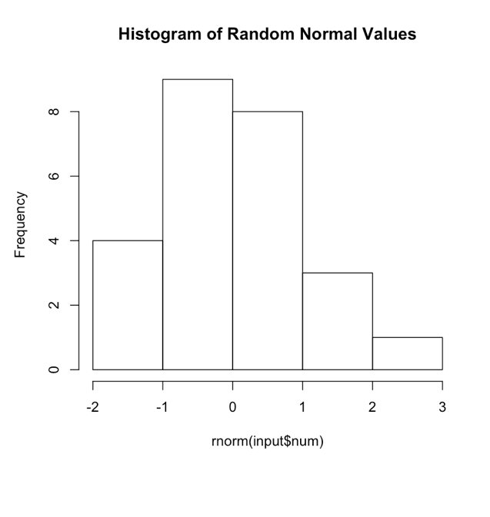
input$num
input$title
output$hist <- renderPlot({ hist(rnorm(input$num),
main = input$title)
})

Slide 58
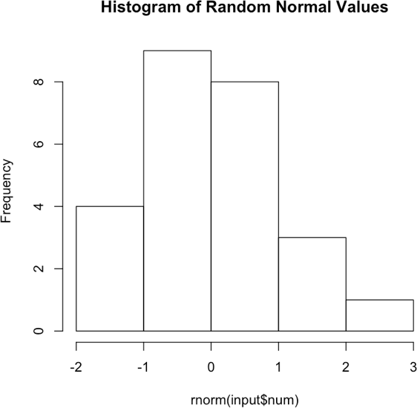
Slides at: bit.ly/shiny-quickstart-2
Recap: render*()
render*() functions make objects to display
output$
Always save the result to output$
render*() makes an observer object that has a
block of code associated with it
output$hist <- renderPlot({ hist(rnorm(input$num),
main = input$title)
})
The object will rerun the entire code block
to update itself whenever it is invalidated
renderPlot( { hist(rnorm(input$num)) })

Slide 59
Modularize code with reactive()

Slide 60
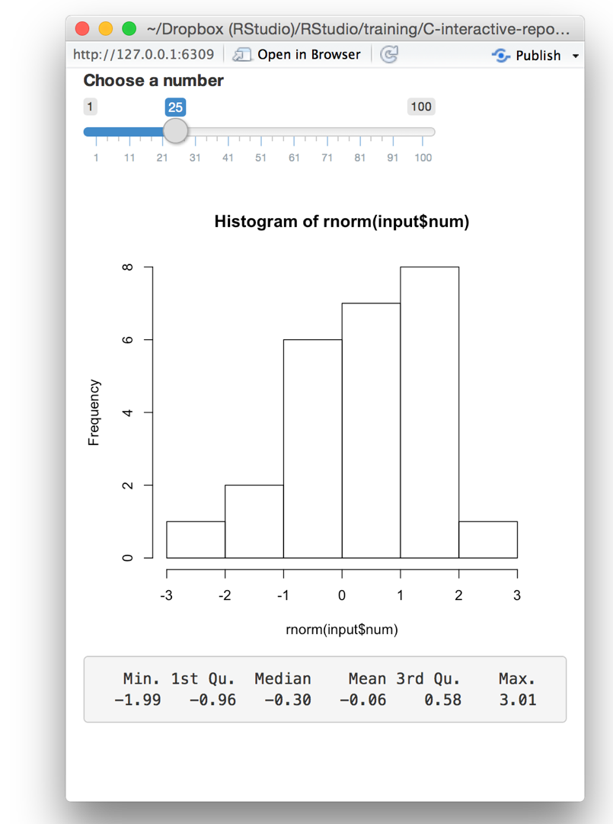
# 02-two-outputs
library(shiny) ui <- fluidPage(
sliderInput(inputId = "num", label = "Choose a number",
value = 25, min = 1, max = 100), plotOutput("hist"), verbatimTextOutput("stats")
)
server <- function(input, output) { output$hist <- renderPlot({
hist(rnorm(input$num))
})
output$stats <- renderPrint({ summary(rnorm(input$num))
})
}
shinyApp(ui = ui, server = server)

Slide 61
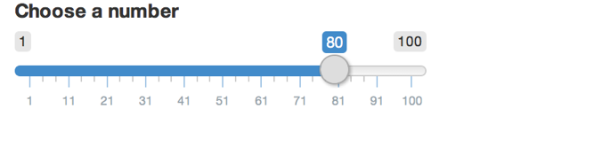
input$num
output$hist <-
renderPlot({ hist(rnorm(input$num))
})
output$stats <- renderPrint({ summary(rnorm(input$num))
})

Slide 62
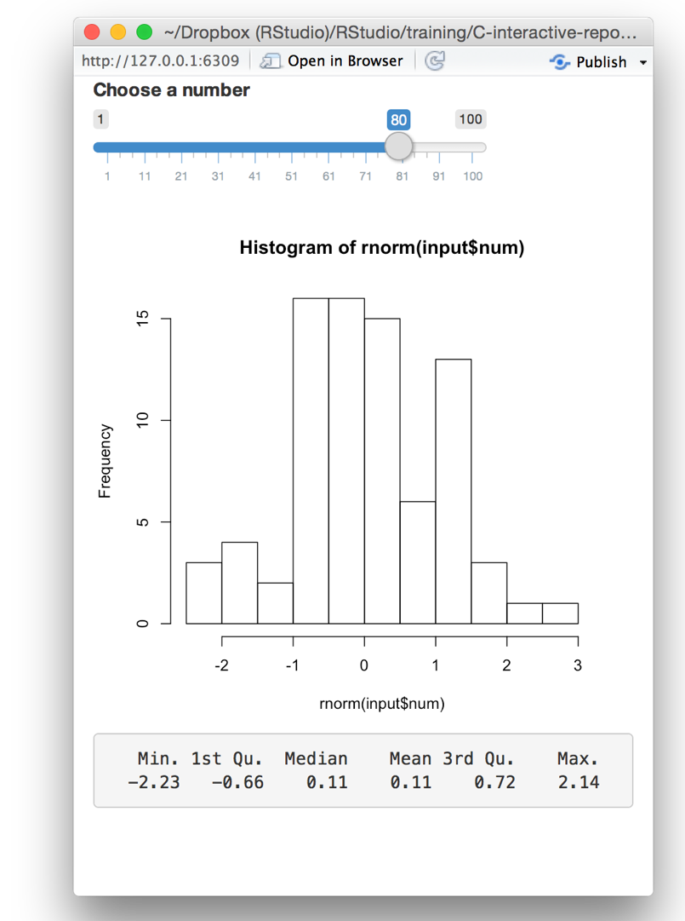
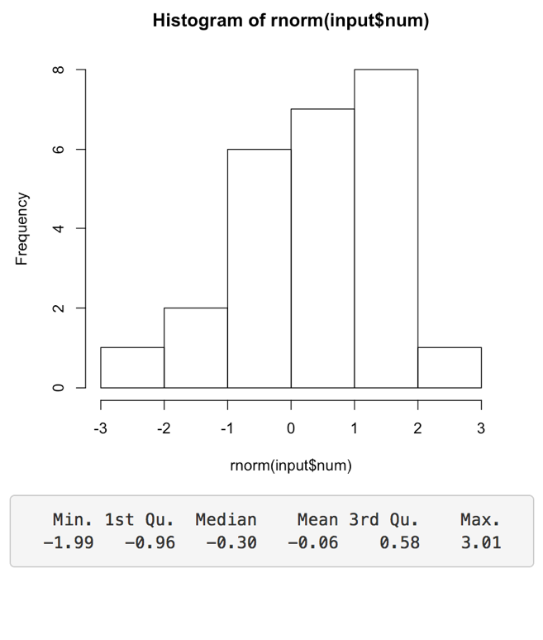
input$num
output$hist <-
renderPlot({ hist(rnorm(input$num))
})
output$stats <- renderPrint({ summary(rnorm(input$num))
})

Slide 63
input$num
Can these describe the same data?
output$hist <-
renderPlot({ hist(rnorm(input$num))
})
output$stats <- renderPrint({ summary(rnorm(input$num))
})

Slide 64
input$num
data <- reactive({ rnorm(input$num)
})
output$hist <-
renderPlot({ hist(data())
})
output$stats <- renderPrint({ summary(data())
})

Slide 65
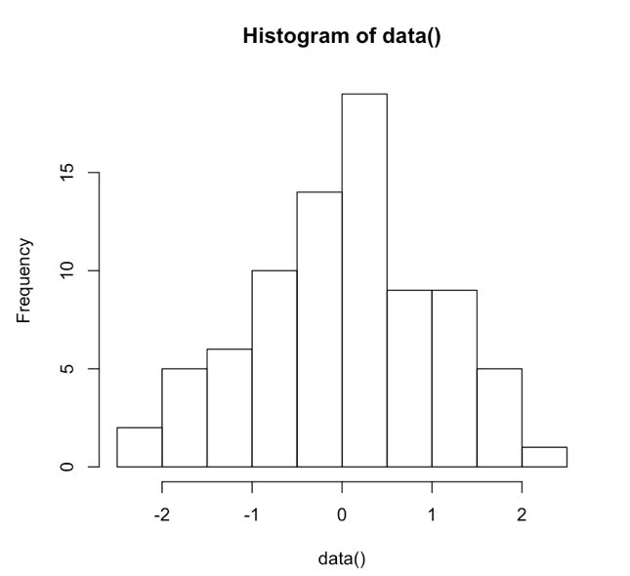
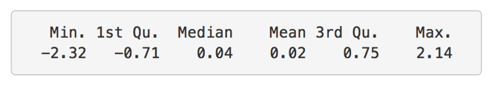
input$num
data <- reactive({ rnorm(input$num)
})
output$hist <-
renderPlot({ hist(data())
})
output$stats <- renderPrint({ summary(data())
})

Slide 66
reactive()
Slides at: bit.ly/shiny-quickstart-2
Builds a reactive object (reactive expression)
data <- reactive( { rnorm(input$num) })
object will respond to every reactive value in the code
code used to build (and rebuild) object

Slide 67
# 03-reactive
library(shiny) ui <- fluidPage(
sliderInput(inputId = "num", label = "Choose a number",
value = 25, min = 1, max = 100),
plotOutput("hist"), verbatimTextOutput("stats")
)
server | <- | function(input, | output) | {
data | <- | reactive({
rnorm(input$num)
})
output$hist <- renderPlot({ hist(data())
})
output$stats <- renderPrint({ summary(data())
})
}
shinyApp(ui = ui, server = server)

Slide 68
A reactive expression is special in two ways
Slides at: bit.ly/shiny-quickstart-2
data()
1
2
You call a reactive expression like a function
Reactive expressions cache their values (the expression will return its most recent value, unless it has become invalidated)

Slide 69
Recap: reactive()
Slides at: bit.ly/shiny-quickstart-2
reactive() makes an object to use (in downstream code)
data <- reactive({ rnorm(input$num)
})
input$num
Reactive expressions are themselves reactive. Use them to modularize your apps.
data <- reactive({ rnorm(input$num)
})
output$hist <- renderPlot({
hist(data())
})
output$stats <- renderPrint({ summary(data())
})
data()
Call a reactive expression like a function
2
Reactive expressions cache their values to avoid unnecessary computation

Slide 70
Prevent reactions with isolate()

Slide 71
Can we prevent
# 01-two-inputs
library(shiny)
the title field from
ui <- fluidPage( sliderInput(inputId = "num",
label = "Choose a number",
updating the plot?
value = 25, min = 1, max = 100), textInput(inputId = "title",
label = "Write a title",
value = "Histogram of Random Normal Values"), plotOutput("hist")
)
server <- function(input, output) { output$hist <- renderPlot({
hist(rnorm(input$num), main = input$title)
})
}
shinyApp(ui = ui, server = server)

Slide 72
isolate()
Slides at: bit.ly/shiny-quickstart-2
Returns the result as a non-reactive value
isolate({ rnorm(input$num) })
object will NOT respond to any reactive value in the code
code used to build object

Slide 73
# 04-isolate
library(shiny) ui <- fluidPage(
sliderInput(inputId = "num", label = "Choose a number",
value = 25, min = 1, max = 100), textInput(inputId = "title",
label = "Write a title",
value = "Histogram of Random Normal Values"), plotOutput("hist")
)
server <- function(input, output) { output$hist <- renderPlot({
hist(rnorm(input$num),
main = isolate({input$title}))
})
}
shinyApp(ui = ui, server = server)

Slide 74
input$num
input$title
output$hist <- renderPlot({ hist(rnorm(input$num),
main = isolate(input$title))
})

Slide 75
input$num
input$title
output$hist <- renderPlot({ hist(rnorm(input$num),
main = isolate(input$title))
})

Slide 76
Recap: isolate()
Slides at: bit.ly/shiny-quickstart-2
○
isolate() makes an non-reactive object
$
Use isolate() to treat reactive values like normal R values

Slide 77
Trigger code
with observeEvent()

Slide 78
Slides at: bit.ly/shiny-quickstart-2
run(this)
input$x
expression()
output$y

Slide 79
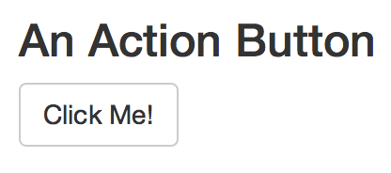
Action buttons
Slides at: bit.ly/shiny-quickstart-2
input function
input name
(for internal use)
label to display
actionButton(inputId = "go", label = "Click Me!")
Notice: Id not ID
© 2015 RStudio, Inc. All rights reserved.

Slide 80
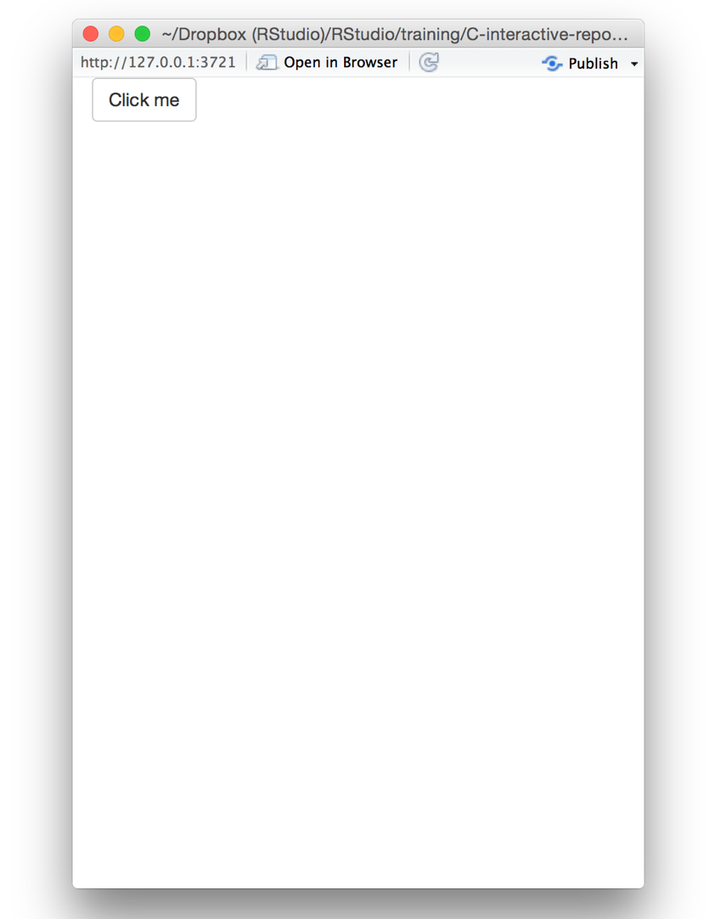
# 05-actionButton
library(shiny)
ui <- fluidPage(
actionButton(inputId = "clicks", label = "Click me")
)
server <- function(input, output) {
}
shinyApp(ui = ui, server = server)

Slide 81
observeEvent()
Slides at: bit.ly/shiny-quickstart-2
Triggers code to run on server
observeEvent(input$clicks, { print(input$clicks) })
reactive value(s) to respond to
code block to run whenever observer is invalidated
note: observer treats this code as if it has been isolated with isolate()
(observer invalidates ONLY when this value changes)

Slide 82
observe()
Slides at: bit.ly/shiny-quickstart-2
Also triggers code to run on server.
Uses same syntax as render*(), reactive(), and isolate()
observe({ print(input$clicks) })
observer will respond to every reactive value in the code
code block to run whenever observer is invalidated

Slide 83
Slides at: bit.ly/shiny-quickstart-2
Recap: observeEvent()
observeEvent() triggers code to run on the server
Specify precisely which reactive values should invalidate the observer
observeEvent(input$clicks, { print(input$clicks) })
reactive value(s) to respond to
observe()
Use observe() for a more implicit syntax

Slide 84
Delay reactions
with eventReactive()

Slide 85
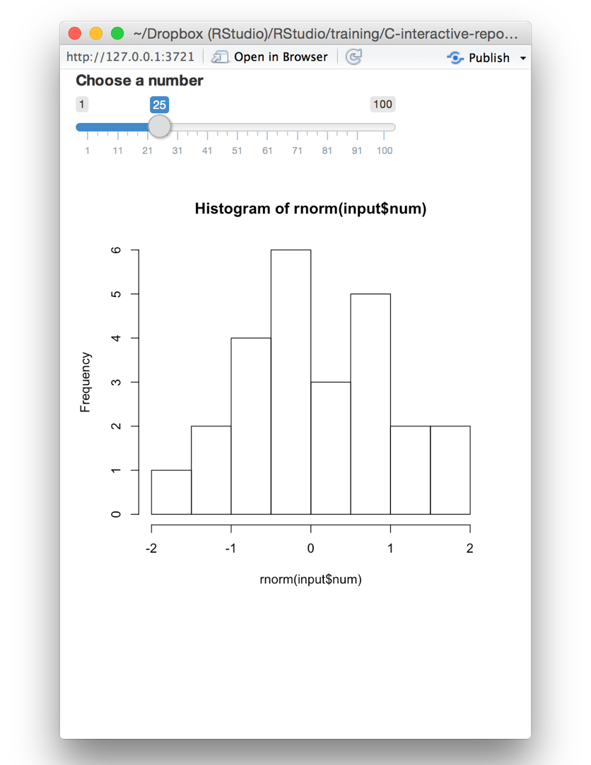
# 07-eventReactive
library(shiny) ui <- fluidPage(
sliderInput(inputId = "num", label = "Choose a number",
value = 25, min = 1, max = 100),
plotOutput("hist")
)
server <- function(input, output) {
output$hist <- renderPlot({ hist(rnorm(input$num))
})
}
shinyApp(ui = ui, server = server)

Slide 86
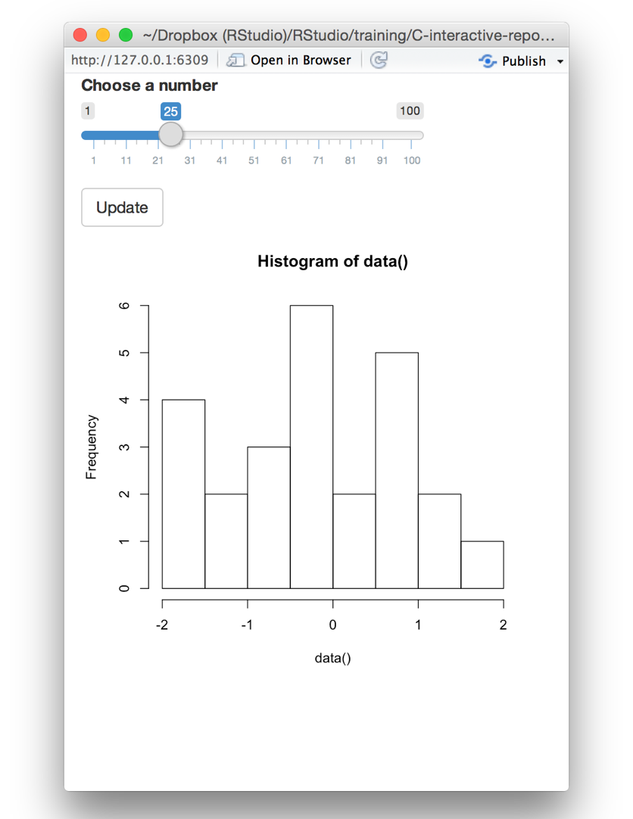
Can we prevent the
# 07-eventReactive
graph from updating
library(shiny)
until we hit the button?
ui <- fluidPage( sliderInput(inputId = "num",
label = "Choose a number",
value = 25, min = 1, max = 100),
actionButton(inputId = "go", label = "Update"),
plotOutput("hist")
)
server <- function(input, output) {
output$hist <- renderPlot({ hist(rnorm(input$num))
})
}
shinyApp(ui = ui, server = server)

Slide 87
eventReactive()
Slides at: bit.ly/shiny-quickstart-2
A reactive expression that only responds to specific values
data <- eventReactive(input$go, { rnorm(input$num) })
reactive value(s) to respond to
code used to build (and rebuild) object
note: expression treats this code as if it has been isolated with isolate()
(expression invalidates ONLY when this value changes)

Slide 88
# 07-eventReactive
library(shiny) ui <- fluidPage(
sliderInput(inputId = "num", label = "Choose a number",
value = 25, min = 1, max = 100), actionButton(inputId = "go",
label = "Update"), plotOutput("hist")
)
server <- function(input, output) {
data <- eventReactive(input$go, { rnorm(input$num)
})
output$hist <- renderPlot({ hist(data())
})
}
shinyApp(ui = ui, server = server)

Slide 89
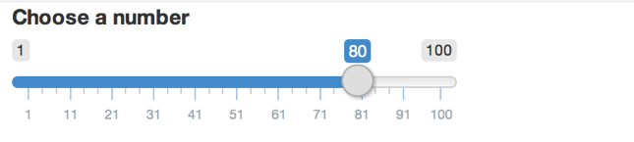
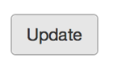
input$go
input$num
data <- eventReactive(input$go, { rnorm(input$num)
})
output$hist <- renderPlot({
hist(data())
})
© 2015 RStudio, Inc. All rights reserved.

Slide 90
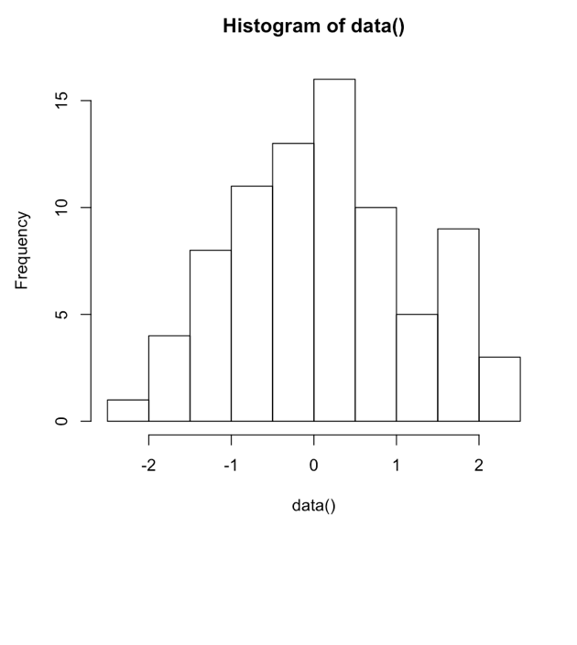
input$go
input$num
data <- eventReactive(input$go, { rnorm(input$num)
})
output$hist <- renderPlot({
hist(data())
})
© 2015 RStudio, Inc. All rights reserved.

Slide 91

Slides at: bit.ly/shiny-quickstart-2
Recap: eventReactive()
Update
Use eventReactive() to delay reactions
data()
eventReactive() creates a reactive expression
You can specify precisely which reactive values should invalidate the expression
eventReactive(input$go, { rnorm(input$num) })
reactive value(s) to respond to
© CC 2015 RStudio, Inc.

Slide 92
Manage state
with reactiveValues()

Slide 93
Slides at: bit.ly/shiny-quickstart-2
Input values
The input value changes whenever a user changes the input.
input$num = 25
input$num = 50
You cannot set these
values in your code
input$num = 75
© 2015 RStudio, Inc. All rights reserved.

Slide 94
reactiveValues()
Slides at: bit.ly/shiny-quickstart-2
Creates a list of reactive values to manipulate programmatically
rv <- reactiveValues(data = rnorm(100))
(optional) elements to add to the list

Slide 95
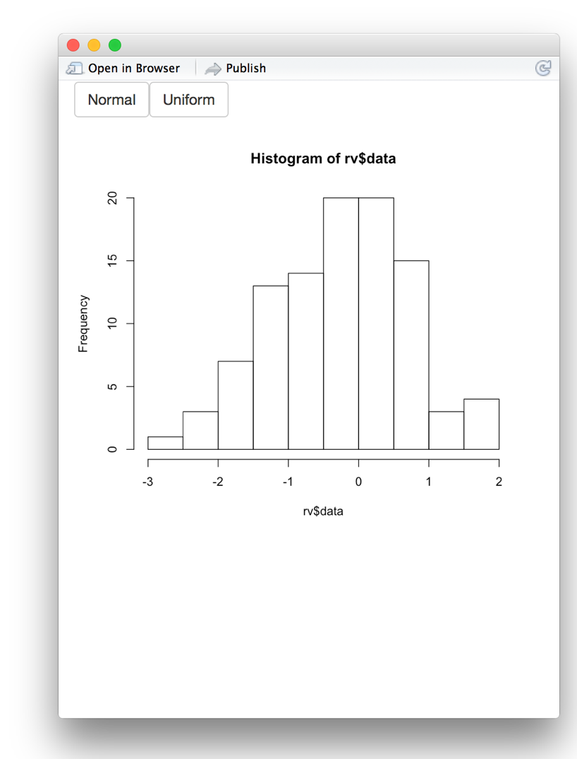
# 08-reactiveValues
library(shiny) ui <- fluidPage(
actionButton(inputId = | "norm", | label | = | "Normal"),
actionButton(inputId = plotOutput("hist") ) | "unif", | label | = | "Uniform"),
server <- function(input, | output) | {
rv <- reactiveValues(data = rnorm(100))
observeEvent(input$norm, | { | rv$data | <- | rnorm(100) | })
observeEvent(input$unif, | { | rv$data | <- | runif(100) | })
output$hist <- renderPlot({ hist(rv$data)
})
}
shinyApp(ui = ui, server = server)

Slide 96


Slides at: bit.ly/shiny-quickstart-2
Recap: reactiveValues()
reactiveValues() creates a list of reactive values
You can manipulate these values (usually with observeEvent())
rv$data <-

Slide 97

Slides at: bit.ly/shiny-quickstart-2
You now how to
Modularize
Trigger arbitrary code
observeEvent() observe()
run(this)
reactions
reactive()
Prevent reactions
isolate()
input$x
expression()
output$y
Create your own reactive values reactiveValues()
Render reactive output render*()
Update
Delay reactions
eventReactive()

Slide 98
Work with the
HTML UI

Slide 99
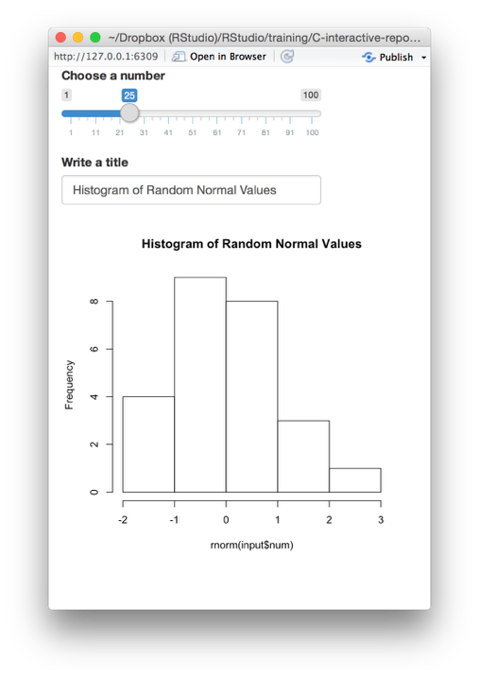

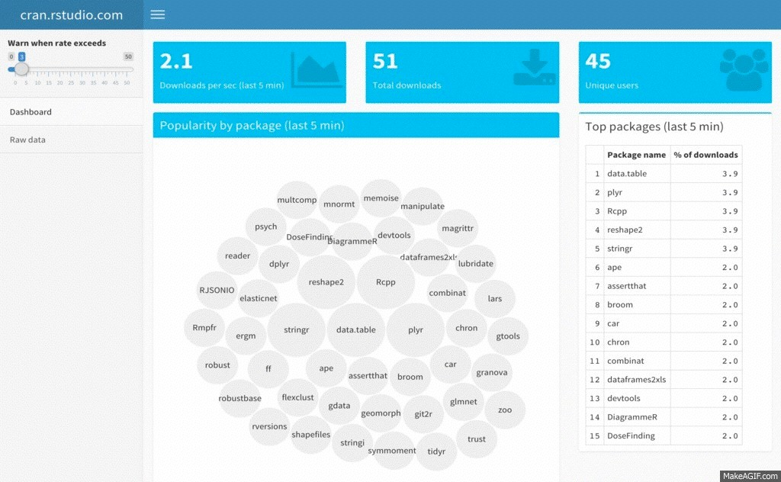
Slides at: bit.ly/shiny-quickstart-3
User Interface
© CC 2015 RStudio, Inc.

Slide 100
The HTML that builds the user interface for your app
Slides at: bit.ly/shiny-quickstart-3
ui <- fluidPage()
fluidPage()
<div class="container-fluid"></div>
© CC 2015 RStudio, Inc.

Slide 101
library(shiny)
ui <- fluidPage( sliderInput(inputId = "num",
label = "Choose a number", value = 25, min = 1, max = 100),
plotOutput("hist")
* Output() adds a space in the ui for an R object.
You must build the object in the server function
)
server <- function(input, output) {
}
shinyApp(ui = ui, server = server)
© CC 2015 RStudio, Inc.

Slide 102
sliderInput(inputId = "num",
label | = | "Choose | a | number",
value | = | 25, min | = | 1, max = | 100)
<div class="form-group shiny-input-container">
<label class="control-label" for="num">Choose a number</label>
<input class="js-range-slider" id="num" data-min="1" data-max="100" data-from="25" data-step="1" data-grid="true" data-grid-num="9.9"
data-grid-snap="false" data-prettify-separator="," data-keyboard="true" data-keyboard-step="1.01010101010101"/>
</div>
plotOutput("hist")
<div id="hist" class="shiny-plot-output" style="width: 100% ; height: 400px"></div>
© CC 2015 RStudio, Inc.

Slide 103


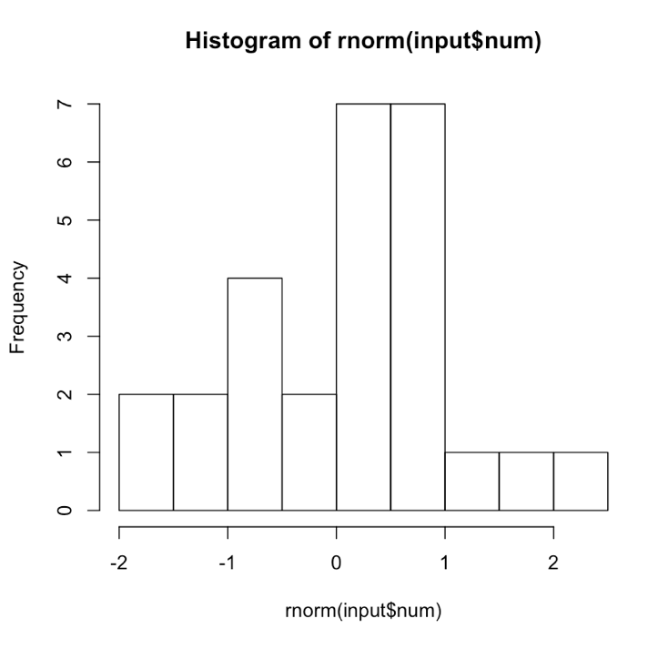
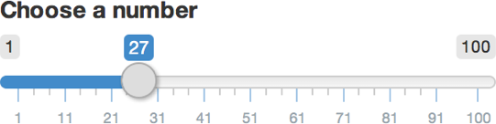
Slides at: bit.ly/shiny-quickstart-3
Recap: User Interface
Call R functions to assemble HTML
fluidPage()
Use fluidPage() to quickly set up a UI
input$num
output$hist
Use input*() and output*() functions to add reactive content.
ui <-
Save the output to ui
© CC 2015 RStudio, Inc.

Slide 104
static content
Add

Slide 105
Slides at: bit.ly/shiny-quickstart-3
How do you add content to a web page?
© 2014 RStudio, Inc. All rights reserved.

Slide 106
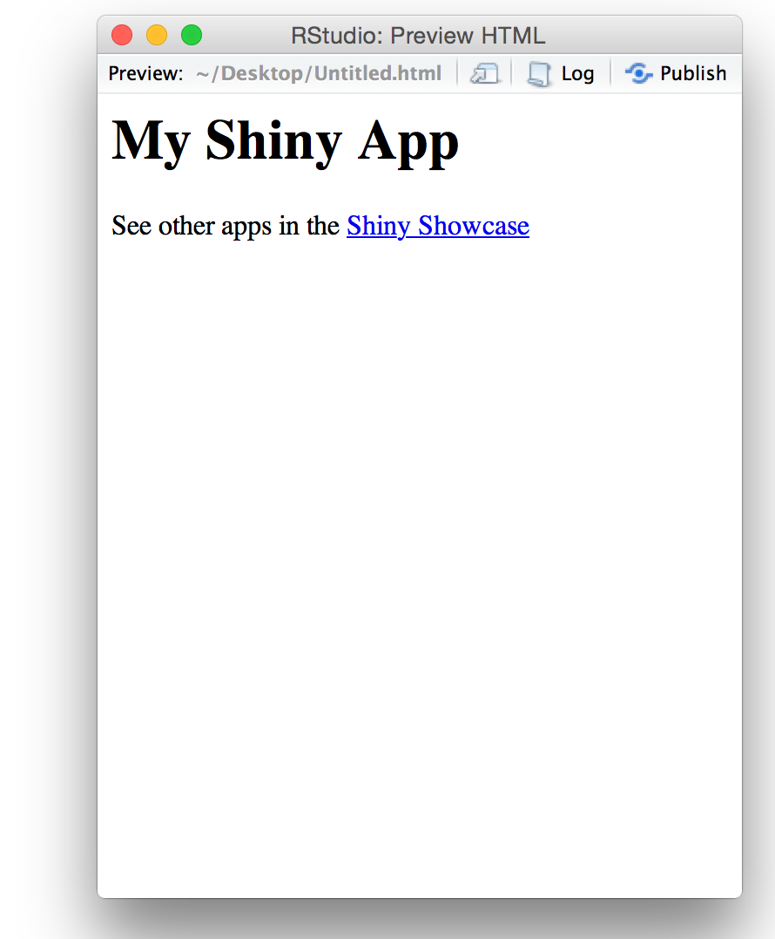
<div class="container-fluid">
<h1>My Shiny App</h1>
<p>See other apps in the
<a href="http://www.rstudio.com/ products/shiny/shiny-user- showcase/">Shiny Showcase</a>
</p>
</div>
© CC 2015 RStudio, Inc.

Slide 107
How do you add content to a web page?
Slides at: bit.ly/shiny-quickstart-3
When writing R, you add content with tags functions.
tags$h1() ~ <h1></h1> tags$a() ~ <a></a>
© 2014 RStudio, Inc. All rights reserved.

Slide 108
tags syntax
Slides at: bit.ly/shiny-quickstart-3
tags$a(href = "www.rstudio.com", "RStudio")
the list named tags
the function/tag name
(followed by parentheses)
named arguments appear as tag attributes
(set boolean attributes to NA)
unnamed arguments appear inside the tags
(call tags$…() to create nested tags)
<a href="www.rstudio.com">RStudio</a>
© CC 2015 RStudio, Inc.

Slide 109
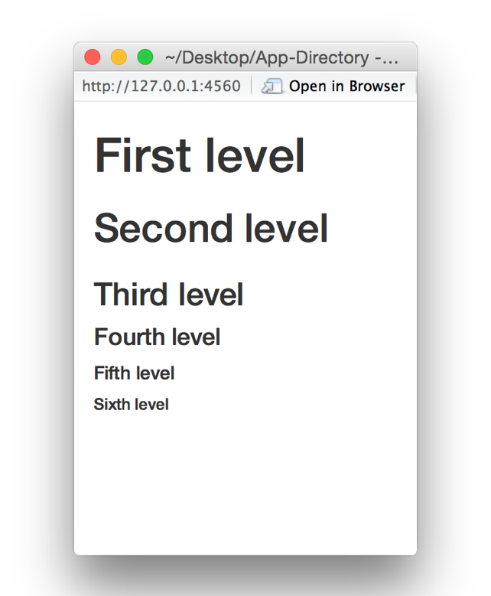
Slides at: bit.ly/shiny-quickstart-3
h1() - h6()
Headers
fluidPage(
tags$h1("First level"), tags$h2("Second level"), tags$h3("Third level"), tags$h4("Fourth level"), tags$h5("Fifth level"), tags$h6("Sixth level")
)
© 2015 RStudio, Inc. All rights reserved.

Slide 110
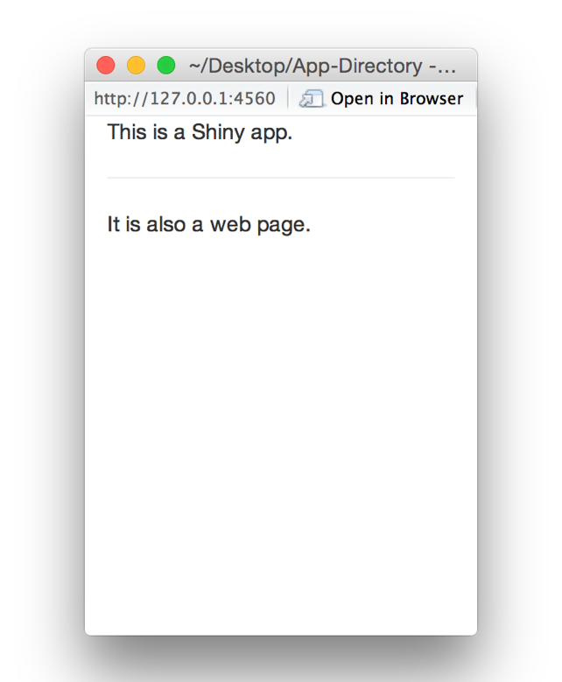
Slides at: bit.ly/shiny-quickstart-3
hr()
A horizontal rule
fluidPage(
"This is a Shiny app.", tags$hr(),
"It is also a web page."
)
© 2015 RStudio, Inc. All rights reserved.

Slide 111
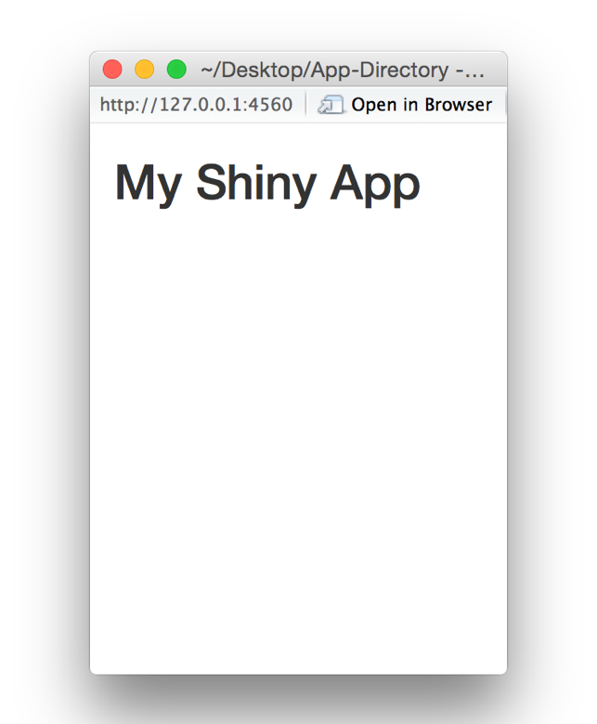
Slides at: bit.ly/shiny-quickstart-3
Raw HTML
Use HTML() to pass a character string as raw HTML
fluidPage(
HTML("<h1>My Shiny App</h1>")
)
© 2015 RStudio, Inc. All rights reserved.

Slide 112
Slides at: bit.ly/shiny-quickstart-3
Recap: Reactive values
names(tags)
## [1] "a"
## [5] "article"
## [9] "base"
## [13] "body"
## [17] "caption"
## [21] "colgroup"
## [25] "dd"
## [29] "div"
## [33] "embed"
## [37] "figure"
## [41] "h2"
## [45] "h6"
"abbr" "aside" "bdi"
"br"
"cite" "command" "del"
"dl"
"address" "audio" "bdo" "button" "code"
"data" "details" "dt"
"area"
"b" "blockquote" "canvas" "col" "datalist" "dfn"
"em" "figcaption" "h1"
"h5"
"hgroup"
Add elements with the tags$ functions
"eventsource" "fieldset"
"footer" "form"
"h3" "h4"
"head" "header"
unnamed arguments are passed into HTML tags
<p id="foo">
foo
</p>
<p id="foo"> foo
</p>
named arguments are passed as HTML tag attributes
Add raw html with HTML()
© CC 2015 RStudio, Inc.

Slide 113
Create a
layout

Slide 114

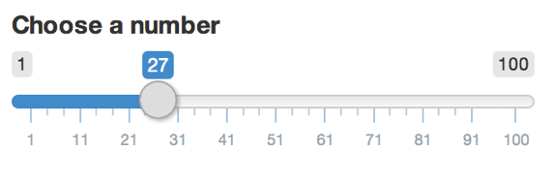
Slides at: bit.ly/shiny-quickstart-3
Use layout functions to position elements within your app
y
x
© 2015 RStudio, Inc. All rights
reserved.

Slide 115

Slides at: bit.ly/shiny-quickstart-3
Slides at: bit.ly/shiny-quickstart-3
Use layout functions to position elements within your app
z
© 2015 RStudio, Inc. All rights
reserved.

Slide 116
Layout functions
Slides at: bit.ly/shiny-quickstart-3
Add HTML that divides the UI into a grid
fluidRow()
<div class="row"></div>
column(width = 2)
<div class="col-sm-2"></div>
© 2015 RStudio, Inc. All rights reserved.

Slide 117
fluidRow()
fluidRow() adds rows to the grid. Each new row goes below the previous rows.
Slides at: bit.ly/shiny-quickstart-3
ui <- fluidPage( fluidRow(), fluidRow()
row 1
row 2
)
© 2014 RStudio, Inc. All rights reserved.

Slide 118
column()
Slides at: bit.ly/shiny-quickstart-3
column() adds columns within a row. Each new column goes to the left of the previous column.
Specify the width and oﬀset of each column out of 12
ui <- fluidPage(
fluidRow( column(3), column(5)),
fluidRow(
column(4, offset = 8)
col 3
col 5
col 4
)
© 2014 RStudio, Inc. All rights reserved.

Slide 119
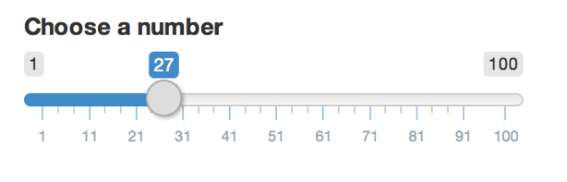

To place an element in the grid, call it as an argument of a layout function
Slides at: bit.ly/shiny-quickstart-3
fluidPage( fluidRow(
column(3),
column(5, sliderInput(…))
),
fluidRow(
column(4, offset = 8, plotOutput("hist")
col 3
col 5
)
)
)
col 4
© 2014 RStudio, Inc. All rights reserved.

Slide 120
Slides at: bit.ly/shiny-quickstart-3
To place an element in the grid, call it as an argument of a layout function
fluidPage( fluidRow(
column(3),
column(5, sliderInput(…))
),
fluidRow(
column(4, offset = 8, plotOutput("hist")
)
)
)
© 2014 RStudio, Inc. All rights reserved.

Slide 121

Slides at: bit.ly/shiny-quickstart-3
Recap: Layout functions
Position elements in a grid, or stack them in layers.
row 1
row 2
Use fluidRow() to arrange elements in rows
col 4 col 4 col 4
col 6 col 6
Use column() to arrange elements in columns
col 4
col 6
Column takes width and oﬀset arguments
© CC 2015 RStudio, Inc.

Slide 122
Assemble
layers
of panels

Slide 123

Slides at: bit.ly/shiny-quickstart-3
Slides at: bit.ly/shiny-quickstart-3
Use layout functions to position elements within your app
z
© 2015 RStudio, Inc. All rights reserved.

Slide 124


Panels
Panels to group multiple elements into a single unit with its own properties.
Slides at: bit.ly/shiny-quickstart-3
http://shiny.rstudio.com/gallery/widget-gallery.html
© 2014 RStudio, Inc. All rights reserved.

Slide 125

wellPanel()
Groups elements into a grey "well"
Slides at: bit.ly/shiny-quickstart-3
# 04-well.R
ui <- fluidPage(
sliderInput("num", "Choose a number", value = 25, min = 1, max = 100),
textInput("title", value = "Histogram", label = "Write a title"),
plotOutput("hist")
)
© 2014 RStudio, Inc. All rights reserved.

Slide 126

wellPanel()
Groups elements into a grey "well"
Slides at: bit.ly/shiny-quickstart-3
# 04-well.R
ui <- fluidPage( wellPanel(
sliderInput("num", "Choose a number", value = 25, min = 1, max = 100),
textInput("title", value = "Histogram",
label = "Write a title"),
),
plotOutput("hist")
)
© 2014 RStudio, Inc. All rights reserved.

Slide 127
absolutePanel() Panel position set rigidly (absolutely), not fluidly
conditionalPanel()
A JavaScript expression determines whether panel is visible or not.
fixedPanel()
Panel is fixed to browser window and does not scroll with the page
headerPanel()
Panel for the app’s title, used with pageWithSidebar()
inputPanel()
Panel with grey background, suitable for grouping inputs
mainPanel()
Panel for displaying output, used with pageWithSidebar()
navlistPanel()
Panel for displaying multiple stacked tabPanels(). Uses sidebar navigation
sidebarPanel()
Panel for displaying a sidebar of inputs, used with pageWithSidebar()
tabPanel() Stackable panel. Used with navlistPanel() and tabsetPanel()
tabsetPanel()
Panel for displaying multiple stacked tabPanels(). Uses tab navigation
titlePanel() Panel for the app’s title, used with pageWithSidebar()
wellPanel() Panel with grey background.
© CC 2015 RStudio, Inc.

Slide 128
tabPanel()
Slides at: bit.ly/shiny-quickstart-3
tabPanel() creates a stackable layer of elements. Each tab is like a small UI of its own.
tabPanel("Tab 1", …)
A title
(for navigation)
elements to appear in the tab
© 2014 RStudio, Inc. All rights reserved.

Slide 129
Slides at: bit.ly/shiny-quickstart-3
Combine tabPanel()’s with one of:
tabsetPanel()
navlistPanel()
navbarPage()
© 2014 RStudio, Inc. All rights reserved.

Slide 130

tabsetPanel()
Slides at: bit.ly/shiny-quickstart-3
tabsetPanel() combines tabs into a single panel. Use tabs to navigate between tabs.
fluidPage( tabsetPanel(
Navigation
tabPanel("tab | 1", | "contents"),
tabPanel("tab | 2", | "contents"),
tabPanel("tab | 3", | "contents")
Content
)
)
© 2014 RStudio, Inc. All rights reserved.

Slide 131


Slides at: bit.ly/shiny-quickstart-3
Slides at: bit.ly/shiny-quickstart-3
tabPanel tabPanel tabPanel
tabsetPanel
© 2015 RStudio, Inc. All rights reserved.

Slide 132

navlistPanel()
Slides at: bit.ly/shiny-quickstart-3
navlistPanel() combines tabs into a single panel. Use links to navigate between tabs.
fluidPage( navlistPanel(
tabPanel("tab | 1", | "contents"),
tabPanel("tab | 2", | "contents"),
tabPanel("tab | 3", | "contents")
Content
)
Navigation
)
© 2014 RStudio, Inc. All rights reserved.

Slide 133
navlistPanel()
Slides at: bit.ly/shiny-quickstart-3
navlistPanel() combines tabs into a single panel. Use links to navigate between tabs.
fluidPage(
navlistPanel(
tabPanel("tab 1", "contents"),
tabPanel("tab 2", "contents"),
tabPanel("tab 3", "contents")
)
)
Examples in 05-tabs.R
Content
Navigation
and 06-navlist.R
© 2014 RStudio, Inc. All rights reserved.

Slide 134




Slides at: bit.ly/shiny-quickstart-3
Recap: Panels
Panels group elements into a single unit for aesthetic or functional reasons
Use tabPanel() to create a stackable panel
Use tabsetPanel() to arrange tab panels into a stack with tab navigation
Use navlistPanel() to arrange tab panels into a stack with sidebar navigation
© CC 2015 RStudio, Inc.

Slide 135

The Shiny Layout Guide
Slides at: bit.ly/shiny-quickstart-3
http://shiny.rstudio.com/articles/layout-guide.html
You can build sophisticated, customized layouts with Shiny’s grid system.
© 2015 RStudio, Inc. All rights reserved.

Slide 136
Use a prepackaged
layout

Slide 137
sidebarLayout()
Slides at: bit.ly/shiny-quickstart-3
Use with sidebarPanel() and mainPanel() to divide app into two sections.
ui <- fluidPage( sidebarLayout(
sidebarPanel(), mainPanel()
sidebar panel
main panel
Example in
)
)
07-sidebar.R
sidebar layout
© 2015 RStudio, Inc. All rights reserved.

Slide 138
# fixedPage()
Creates a page that defaults to a width of 724, 940, or 1170 pixels (depending on browser window)
Slides at: bit.ly/shiny-quickstart-3
ui <- fixedPage(
fixedRow( column(5, # etc.)
)
)
Use with fixedRow()
Compare to fluidPage() and fluidRow() which adjust
to browser window
© 2015 RStudio, Inc. All rights reserved.

Slide 139


navbarPage()
Slides at: bit.ly/shiny-quickstart-3
navbarPage() combines tabs into a single page. navbarPage() replaces fluidPage(). Requires title.
navbarPage(title = "Title",
tabPanel("tab 1", "contents"),
tabPanel("tab 2", "contents"),
tabPanel("tab 3", "contents")
)
Navigation
Content

Slide 140
Slides at: bit.ly/shiny-quickstart-3
Slides at: bit.ly/shiny-quickstart-3
tabPanel tabPanel tabPanel
tabsetPanel

Slide 141

Slides at: bit.ly/shiny-quickstart-3
Slides at: bit.ly/shiny-quickstart-3
tabPanel tabPanel tabPanel tabPanel
navbarPage
© 2015 RStudio, Inc. All rights reserved.

Slide 142

navbarMenu()
Slides at: bit.ly/shiny-quickstart-3
navbarMenu() combines tab links into a dropdown menu for navbarPage()
navbarPage(title = "Title",
tabPanel("tab 1", "contents"),
tabPanel("tab 2", "contents"), navbarMenu(title = "More",
tabPanel("tab 3", "contents"),
tabPanel("tab 4", "contents"),
tabPanel("tab 5", "contents")
)
)
© 2014 RStudio, Inc. All rights reserved.

Slide 143

dashboardPage()
Slides at: bit.ly/shiny-quickstart-3
dashboardPage() comes in the shinydashboard package
library(shinydashboard)
ui <- dashboardPage( dashboardHeader(), dashboardSidebar(), dashboardBody()
)
© 2014 RStudio, Inc. All rights reserved.

Slide 144


shinydashboard
http://rstudio.github.io/shinydashboard/
Slides at: bit.ly/shiny-quickstart-3
A package of layout functions for building administrative dashboards with Shiny
Dynamic Dashboards with Shiny Webinar:
www.rstudio.com/resources/webinars/
© 2015 RStudio, Inc. All rights reserved.

Slide 145


Recap: Prepackaged Layouts
Slides at: bit.ly/shiny-quickstart-3
Use sidebarLayout() with sidebarPanel() and
mainPanel() to quickly create a sidebar design.
#
Use fixedPanel() with fixedrow() to create a fixed (non-fluid) design
Use navbarPage() with navbarMenu() to create "multipage" app
Use the shinyDashboard package to create dashboard layouts
© CC 2015 RStudio, Inc.

